Slide 1
webVR (Virtual Reality)
Date: 20th April 2016
Akshay Patil & UX team

Slide 2
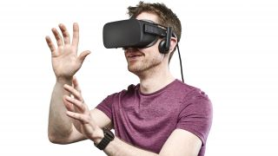
Describe your INNOVATIVE IDEA
Virtual reality (VR) typically refers to computer technologies that use virtual reality headsets to generate the realistic images, sounds and other sensations that replicate a real environment or create an imaginary setting. VR also simulates a user's physical presence in this environment.
A person using virtual reality equipment is able to "look around" the artificial world, and with high quality VR move about in it, and interact with features or items depicted in the headset.

Slide 3
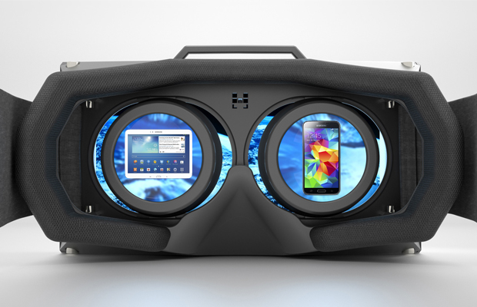
Describe your INNOVATIVE IDEA
But to run VR we need a complete software setup. So to overcome from this problem we use webVR. As web is accessible to everyone and everywhere. It only needs a web browser and a VR headset for better 3D experience with a device having Gyroscope sensor (A sensor which detects the orientation of the device which now a days is present in all the modern smartphones).

Slide 4
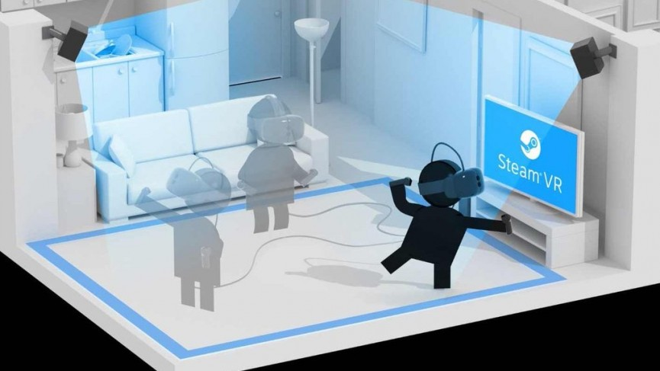
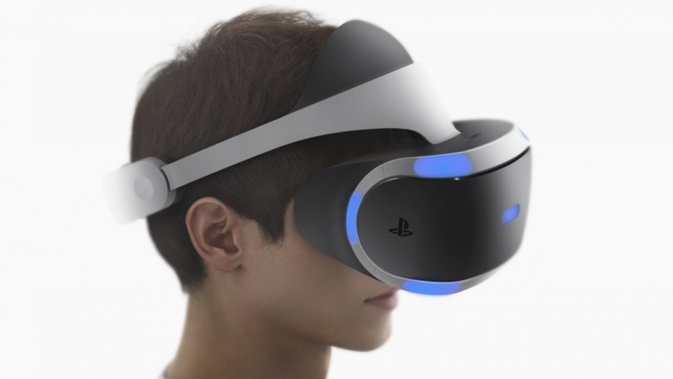
Describe your INNOVATIVE IDEA
Some great features of webVR.
Motion tracking
Head tracking

Slide 5
Which Problem Area will it address once implemented?
webVR is very powerful and useful for educational purposes. The use of webVR as a training tool is well known.
Below are some benefits of webVR.
Little/no risk
Safe, controlled area
Realistic scenarios
Can be done remotely saving time and money
Improves retention and recall
Simplifies complex problems/situations
Suitable for different learning styles
Innovative and enjoyable
The last item is an important one. Training is easier if the experience is pleasant or enjoyable which means higher level of engagement and understanding.

Slide 6
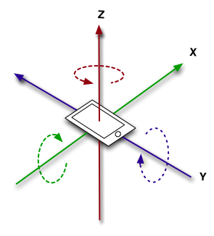
What kind of Research & Development efforts will you be taking?
Currently I am working on this and demo is ready but there are some points we have to research to make it more efficient and light for great experience.
Rendering Speeds: Speed of processing device by which the 3D objects are getting created.
Gyroscope Sensor: All modern smartphone have this sensor but we will have to think about the old smartphones which don’t have this sensor.

Slide 7
What would be the Organization Impact / Value add?
We can make very innovative and new type of e-learning 3D modules which we are currently make in website form. This will become very interesting and new experience for our users.
We can catch their eyes and concentrate on what we want to and in this way it will be more interesting for the users.
The users will have to interact which the objects what we are having in our courses. Which can be rememberable for the users.

Slide 8
How would you implement this Idea? Please suggest detailed action plan

Slide 9
What would be the estimated project timeline & the anticipated closure date?

Slide 10
What would be the team’s collaboration efforts during implementation?

Slide 11
Do you estimate a Budget/Cost for implementation? Please share details

Slide 12
Have a Design/Prototype ready? Please showcase it here. *(optional)

Slide 13
Any Additional Details/Comments you would like to mention?

